Slide 1
Supervision in ML and GAN
Ruichen MA, 2024/9/2

Slide 2
Motivation
Models trained under different levels of supervision have huge contrast
Knowing about differently trained models and their usage helps to better understand the framework of LLM

Slide 3
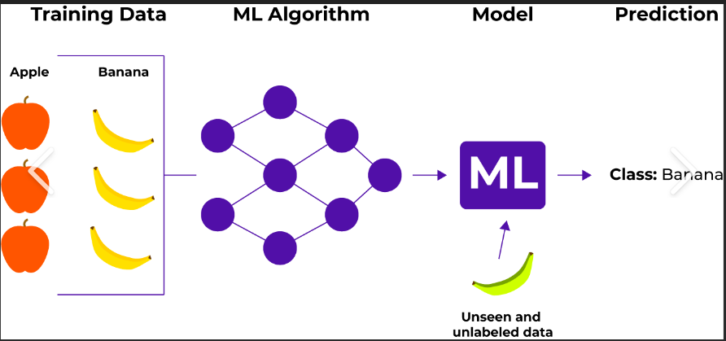
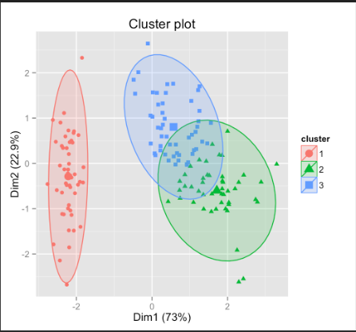
Supervised learning (trained with labeled data )
Classification Identification
(Classification model)
VS
Unsupervised learning (trained with not-labelled data)
Clustering feature extracting
(Generative model)

Slide 4
Different levels of supervision
Supervised learning
Unsupervised learning
Semi-supervised learning (Little labelled data)
Self-Supervised Learning (models create label)
Weakly supervised learning (labels are not perfect)

Slide 5
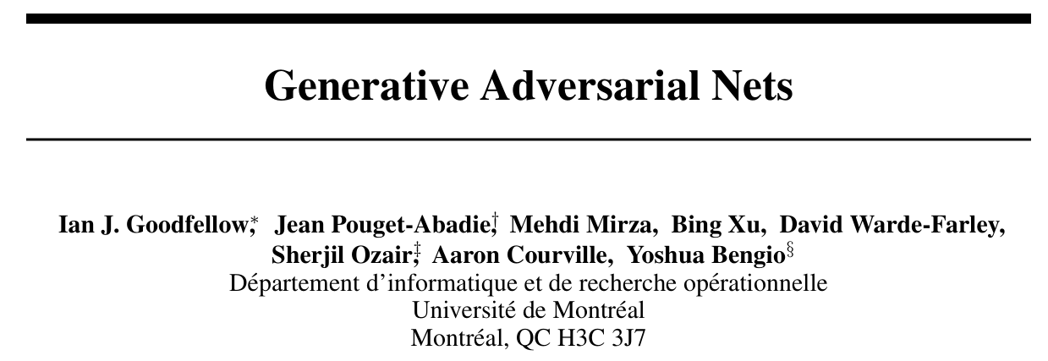
GAN: An example of Unsupervised learning method
71715 cites

Slide 6
Parts of the article
Abstract
Introduction
Related work
Adversarial nets
Theoretical results (skipped)
Experiments
Advantage and disadvantages
Conclusions and future work

Slide 7
Abstract
Core idea: train two adversarial models G and D, with G imitating the sample,
D trying to distinguish G’s creation

Slide 8
Introduction
Existing difficulties of deep generalization models
New method to overcome it

Slide 9
Related work
Comparison with
VAEs(variational autoencoders): use second neuro network, but it is a recognition model
NCE(Noise-contrastive estimation): using a discriminative criterion, but the discriminator is defined by the ratio of the probability densities of the noise distribution and the model distribution

Slide 10
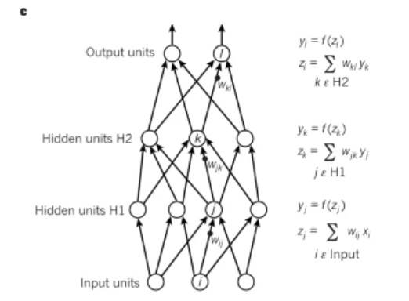
predictability minimization: having two neural networks compete, but the second neuro network only tries to predict the value of that hidden unit given the value of all of the other hidden units.
Keep its independence

Slide 11
Adversarial nets
D(x) represents the probability that x came from the data rather than pg

Slide 12
Theoretical Results
Extension of formulas

Slide 13
Experiments
Trained on MNIST,TFD,CIFAR-10
“We estimate probability of the test set data under pg by fitting a Gaussian Parzen window to the samples generated with G and reporting the log-likelihood under this distribution. ”

Slide 14
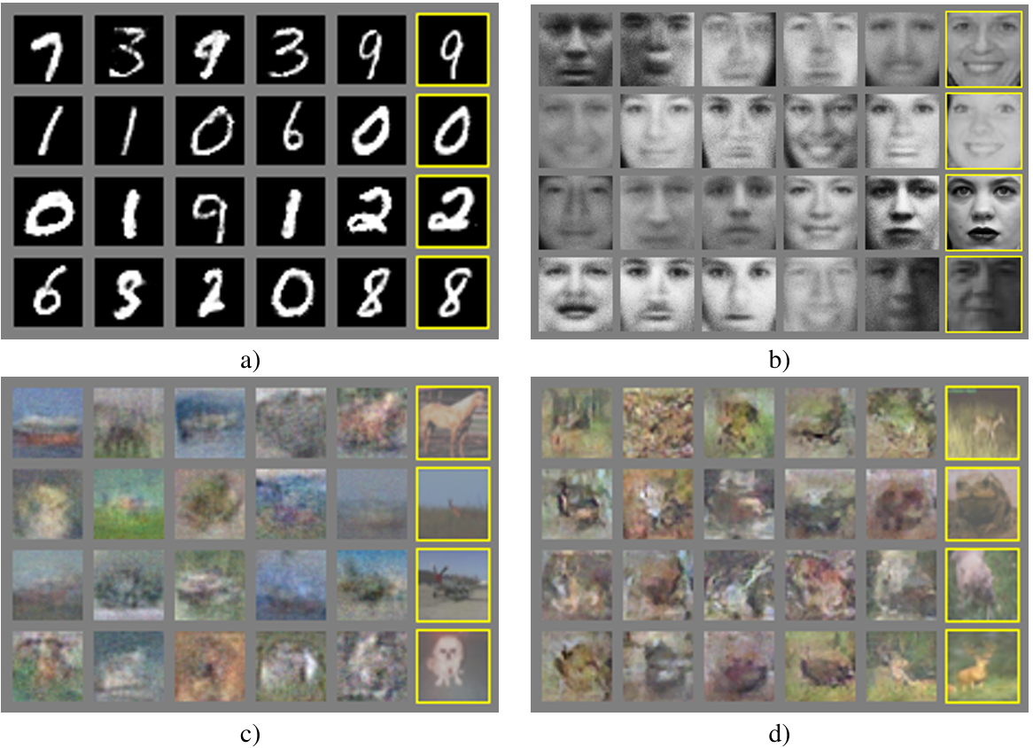
Outcome
Right columns are samples, left are produced by the model

Slide 15
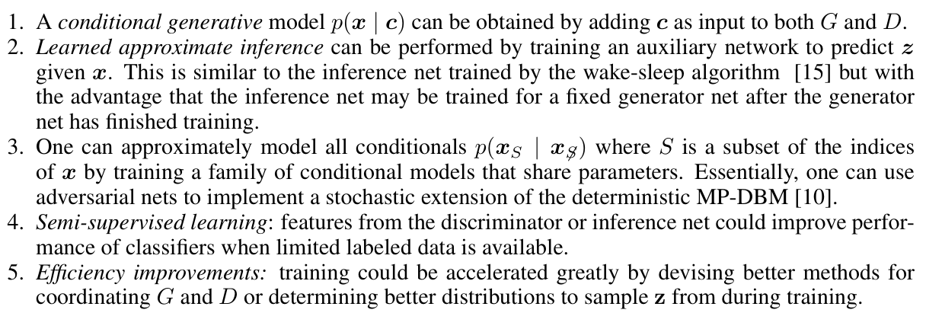
Conclusions and future work

Slide 16
Takeaway
Interesting related work: achievements can be made even by combining previous work
Find extension to exaggerate achievement

Slide 17
Reference
Goodfellow, I., Pouget-Abadie, J., Mirza, M., Xu, B., Warde-Farley, D., Ozair, S., ... & Bengio, Y. (2014). Generative adversarial nets. Advances in neural information processing systems, 27.
https://poe.com/

